Slide 1
LSTM model
time series anomaly detection

Slide 2
Basic Long Short Term Memory (LSTM)
Model type
application
The aim of impliment
LSTM is a type of deep learning model that is mostly used for analysis of sequential data (time series data prediction).
There are different application areas that are used: Language model, neural machine translation, music generation, time series prediction, financial prediction, etc.
The aim of this implementation is to help to learn structure of basic LSTM (LSTM cell forward, LSTM cell backward, etc..).

Slide 3
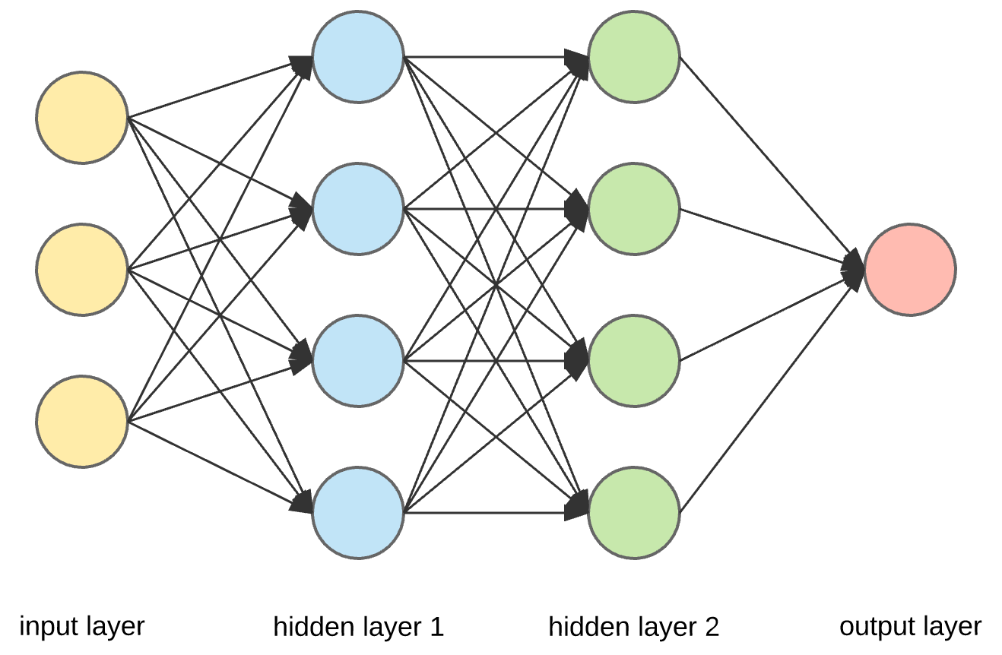
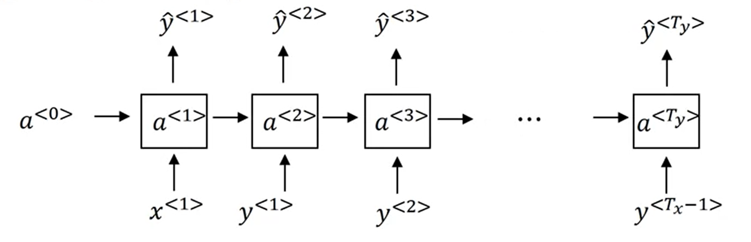
Standard NN
RNN

Slide 4
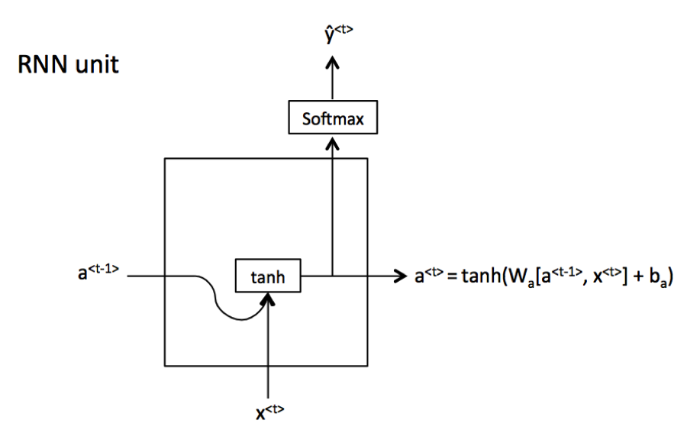
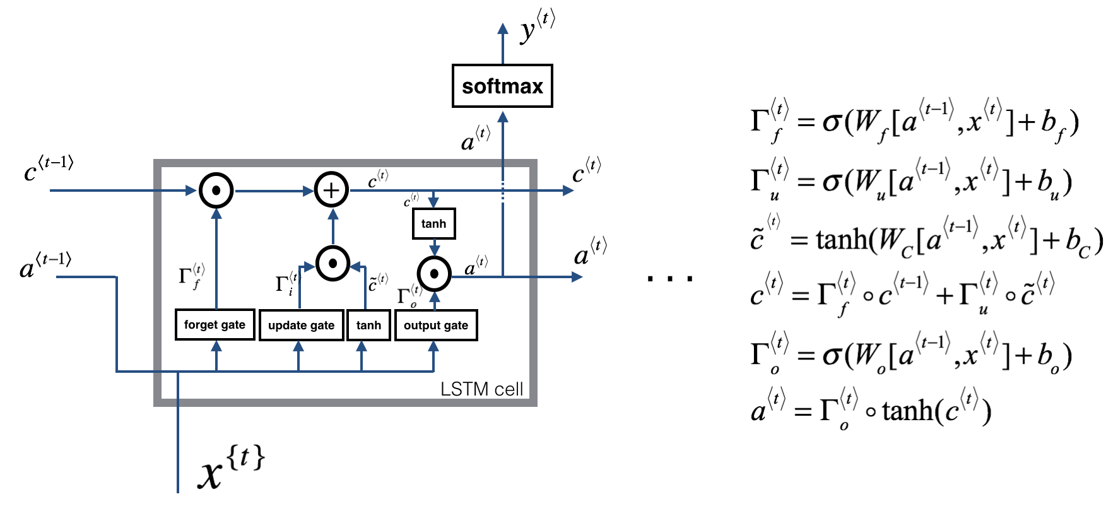
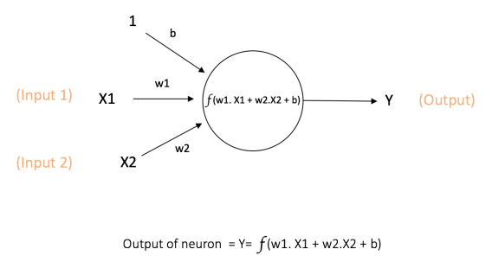
Types of NN
Standard NN
RNN
RNN with LSTM unit

Slide 5
LSTM Cell
Type of RNN units

Slide 6
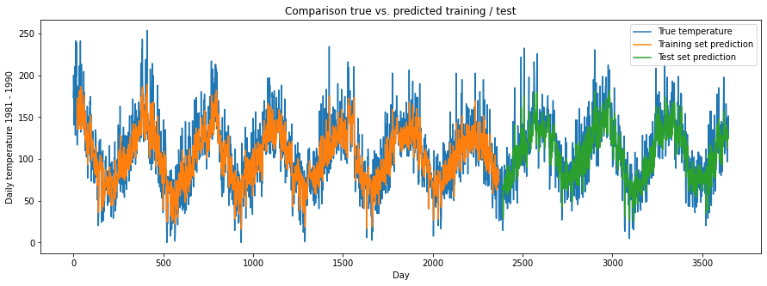
Results Dataset 1

Slide 7
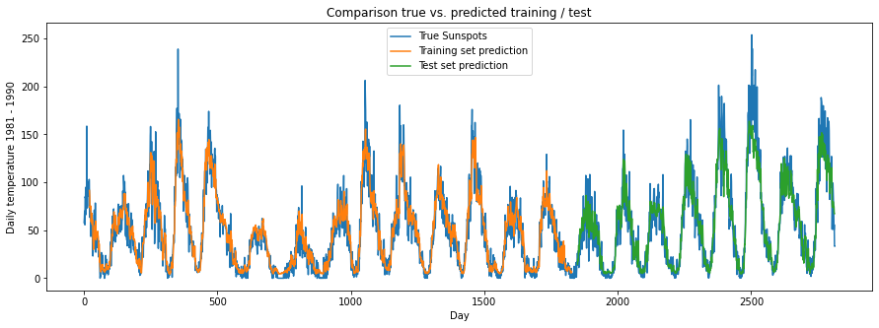
Results dataset 2

